Slide 1

Capstone Design Project 2
Sean Barrick

Slide 2
Overview
Capstone Project Overview: Optimizing IoT Devices w/ WIFI-6 & Comparing + Contrasting with v4 and v5.
The goals for Sprint 2:
Collaborate with Leahy Center
Finish Network Design
Finish Research for WIFI and IoT
Finish Hardware/Software Research
This presentation will go to show off what has been accomplished towards these goals, what was unmet, as well as adjustments as this project goes forward.

Slide 3
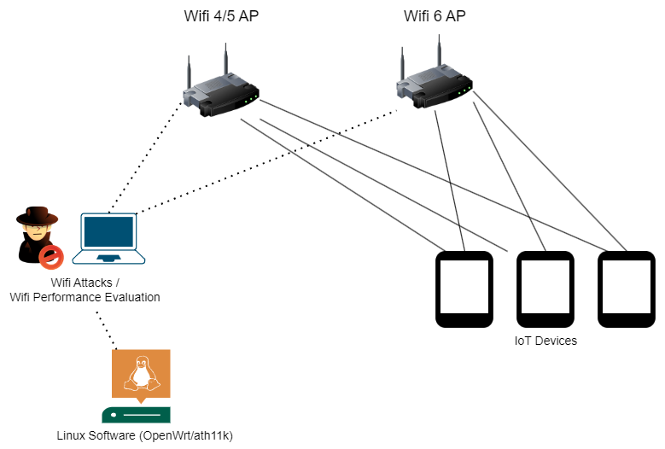
Network Design
This network design is a work-in-progress, and may change as I go on with the project.
This gives a basic idea of the type of network or visual overview of the project.
There is 2 sets of Access Points for the different versions of 802.11
They will connect to software with OpenWrt and ath11k into order to tweak the settings of the different Wifis
Not shown here, but the laptop will also use Kali Software to initiate cyber attacks against all different versions of 802.11.

Slide 4


Software/Hardware Research
Research has been a mixed bag during this sprint, though some great strides have been made
Software:
OpenWrt (Linux OS) that can be used to “tweak” settings of Wifi 6 routers and access points.
Ath11k (Linux Driver) that helps in conjunction with OpenWrt where it is limited in tweaking.
Hardware:
500 Series of Aruba Access Point. This will be my main “router” that will is Wifi 6 compatible
Still need to lock down purchasing the device, but that will change soon.
Found on Arubas site (though have to be a business to talk with sales), Ebay/Amazon for ~$500

Slide 5
Collaboration with the Leahy Center
Over my sprint I’ve been working towards getting into collaboration for my project with the Leahy Center
Was able to talk into possibly working within IoT labs to further research my capstone project as well as get a look into IoT research
Will update with documentation on research if I get in.

Slide 6
Setbacks
Some setbacks happened during my sprint.
Covid
Unmet tasks:
IoT Research
WIFI Research
Costs

Slide 7
Github Page
Link to Github page:
https://github.com/seabar24/Capstone/blob/Home/DesignProject2.md
Goes a little more in-depth into the project over the sprint. As well as different links to different parts of the project

Slide 8
Thank you!

